Slide 1
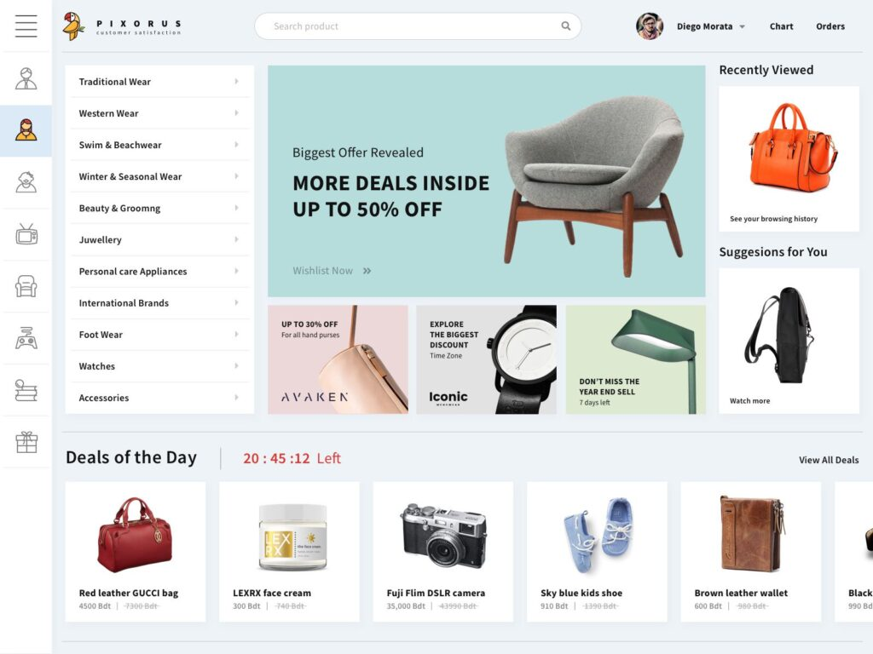
E-Commerce Website
Step1: User Registration and Login
Users can register with their details and log in to their account.
Step2: Pagination and Product Display
Display a list of products details like name, description,
price, and image.
Step3: Previously Viewed Products
Users can view the products they have previously viewed.
Step4: Shopping Cart
Users can add products to their cart and view them in the cart page.
Step5: Bill Calculation
After adding products to the cart, users can proceed to the checkout page, where the total price is calculated.

